Slide 1
pollination is important
A is a dance between species
B is a dance that doesn’t happen in isolation. Often species dance with multiple partners
A the number of partners a species has is a defining feature of the species role in the community
T understanding what are the implications of having multiple partners is important
at the species level, the number of partners defines whether a species is a specialist or a generalist
B we need to remember that partnerships are embedded in a intertwined network of interactions
A at the species level the number of partners and how they are shared defines the structure of this network
T to understand the implications of having multiple partners we need to take into account this network and its structure
This is the theme of my thesis: understanding the causes and consequences of the network structure from a specialisation/generalisation perspective
I have three chapters. Being extremely simplistic I start by exploring things that affect the number of “dancing” partners, then move into how the number of partners can affect the pollination how good the “dance” is and finally whether there are “key dancers” that we could use for improved management and conservation

Slide 2
POLLINATION
supports
global biodiversity &
crop production
Notes:
important for the maintenance of biodiversity
between 7 and 30% of crops production worldwide depends to some extent on pollination

Slide 3
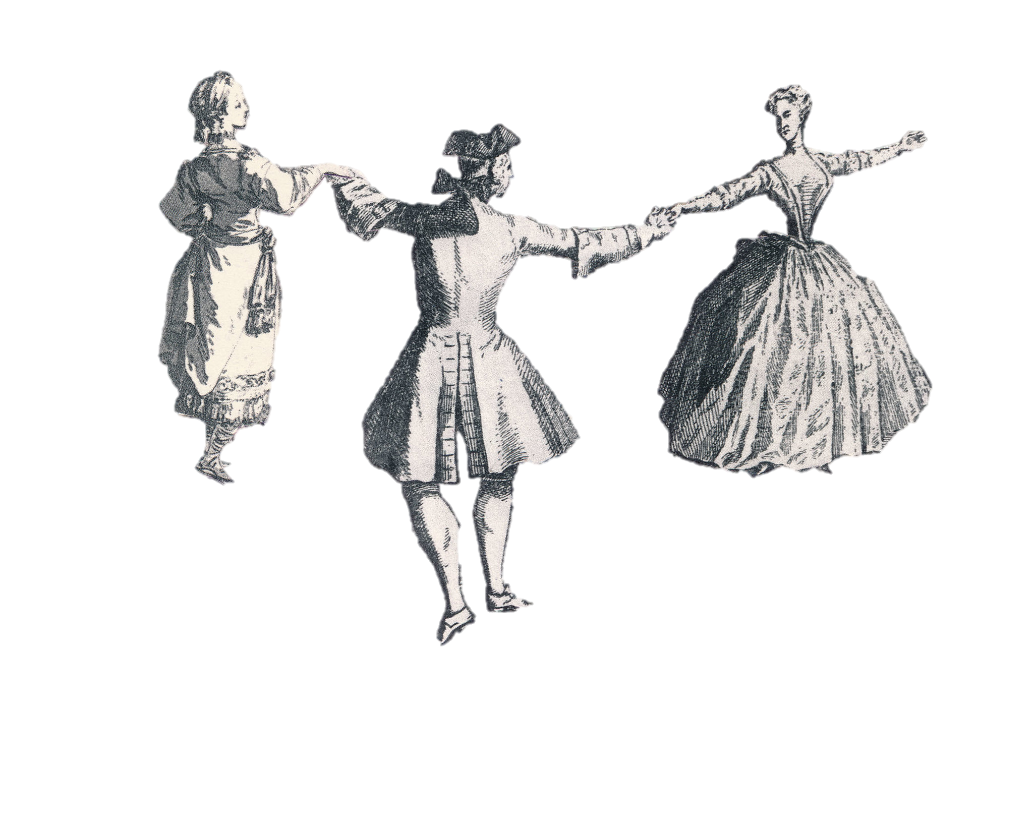
what are the implications of
having multiple partners?
Illustration: Joanna Neborsky – The New York Times
Notes:
A is a dance between species
B is a dance that doesn’t happen in isolation. Often species dance with multiple partners
A the number of partners a species has is a defining feature of the species role in the community
T understanding what are the implications of having multiple partners is important

Slide 4
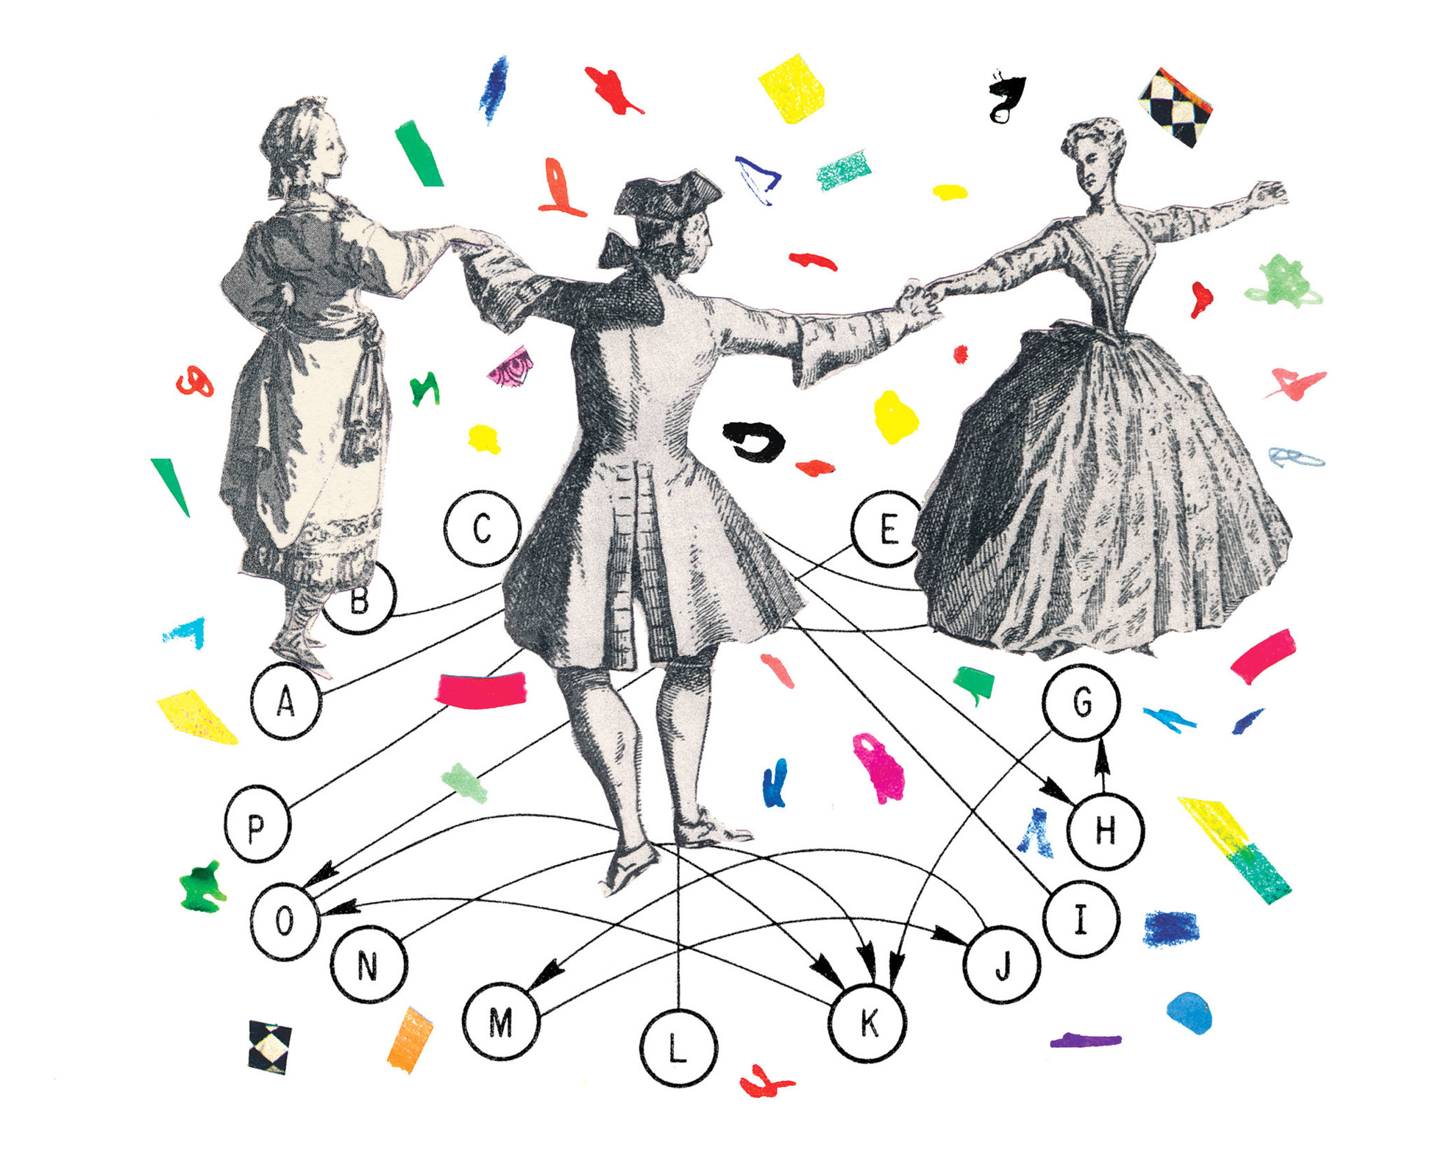
partnerships are embedded in
a complex network of interactions
Illustration: Joanna Neborsky – The New York Times
Notes:
at the species level, the number of partners defines whether a species is a specialist or a generalist
B we need to remember that partnerships are embedded in a intertwined network of interactions
A at the species level the number of partners and how they are shared defines the structure of this network
T to understand the implications of having multiple partners we need to take into account this network and its structure

Slide 5

PLANT POLLINATOR COMMUNITIES
environmental gradients, trade-offs, and controllability
Notes:
This is the theme of my thesis: understanding the causes and consequences of the network structure from a specialisation/generalisation perspective

Slide 6
PLANT POLLINATOR COMMUNITIES
a specialisation / generalisation perspective
Notes:
I do this from a generalisation specialisation perspective

Slide 7
WHAT ARE THE CAUSES?
Notes:
I have three chapters. Being extremely simplistic I start by exploring things that affect the number of “dancing” partners,

Slide 8
WHAT ARE THE CAUSES?
WHAT ARE THE CONSEQUENCES?
Notes:
then move into how the number of partners can affect the pollination how good the “dance” is

Slide 9
WHAT ARE THE CAUSES?
WHAT ARE THE CONSEQUENCES?
CAN WE USE IT?
Notes:
and finally whether there are “key dancers” that we could use for improved management and conservation
.
Chronologically it actually happened the other way around. I first wrote the third chapter of the thesis, then second and the first last.

Slide 10
there is good reason to think that environment can affect specialisation, shapes species distributions and link between interactions as well as structure
A several studies have investigated this
B a general relationship has been elusive, environment can have multiple factors and species respond differently
T we use a different approach. first use stress instead of env. variables and that allowed us to discover interesting patterns. second we use a lot of data: we use a global dataset 73 locations around the world and ~ 10k species. Over 40 million occurrences 37 variables – climate and topography for estimating stress.
we found that there some species tend to be like this – specialists but tend to interact with others as stress increases and other like this – generalists that tended to interact with more as species
the patterns were true for
Notes:
there is good reason to think that environment can affect specialisation, shapes species distributions and link between interactions as well as structure
A several studies have investigated this
B a general relationship has been elusive, environment can have multiple factors and species respond differently
T we use a different approach. first use stress instead of env. variables and that allowed us to discover interesting patterns. second we use a lot of data: we use a global dataset 73 locations around the world and ~ 10k species. Over 40 million occurrences 37 variables – climate and topography for estimating stress.

Slide 11

EFFECT OF THE ENVIRONMENT ON SPECIALIZATION
Notes:
there is good reason to think that environment can affect specialisation, shapes species distributions and link between interactions as well as structure
A several studies have investigated this
B a general relationship has been elusive, environment can have multiple factors and species respond differently
T we use a different approach. first use stress instead of env. variables and that allowed us to discover interesting patterns. second we use a lot of data: we use a global dataset 73 locations around the world and ~ 10k species. Over 40 million occurrences 37 variables – climate and topography for estimating stress.

Slide 13
we found contrasting patterns
results of a hierarchical Bayesian binomial regression; R² = 0.89

Slide 14
some interact with more
a long-tongued bumblebee
Bombus diversus
results of a hierarchical Bayesian binomial regression; R² = 0.89

Slide 15
some interact with fewer
a long-tongued bumblebee
Bombus diversus
a common hoverfly
Syrphus vitripennis
results of a hierarchical Bayesian binomial regression; R² = 0.89

Slide 16
many species follow the same patterns
results of a hierarchical Bayesian binomial regression; R² = 0.89

Slide 17
the correlation between slope and intercept is significant
results of a hierarchical Bayesian binomial regression; R² = 0.89

Slide 18

TRADE-OFFS OF SHARING POLLINATORS
Notes:
So in the first chapter we look that species can have a gradient of generalisation specialisation In their communities. Now we look at what are the implications of that. The base hypothesis is that the more partners you share the better you’re in the short long term but the worse the pollinatin might the sort term
Because of pollen loses
This is a question that has been rarely explored at the community level.
So we look at that this but at the community level other things happen, abundance, visitation, traits. It all gets mingled.

Slide 19
pollination quantity
pollination purity
← negative effect
positive effect →
← negative effect
positive effect →
results of a 1000 bootstrap replicates of models of deposited conspecific and heterospecific pollen

Slide 20
sharing pollinators not good
pollination quantity
pollination purity
← negative effect
positive effect →
← negative effect
positive effect →
results of a 1000 bootstrap replicates of models of deposited conspecific and heterospecific pollen

Slide 21
but being original is good
pollination quantity
pollination purity
← negative effect
positive effect →
← negative effect
positive effect →
results of a 1000 bootstrap replicates of models of deposited conspecific and heterospecific pollen

Slide 22
being abundant has trade-offs
pollination quantity
pollination purity
← negative effect
positive effect →
← negative effect
positive effect →
results of a 1000 bootstrap replicates of models of deposited conspecific and heterospecific pollen

Slide 23
having lots of pollen transferred by visitors also has trade-offs
pollination quantity
pollination purity
← negative effect
positive effect →
← negative effect
positive effect →
results of a 1000 bootstrap replicates of models of deposited conspecific and heterospecific pollen

Slide 24
variables that are mediated by number of partners
induce trade-offs
in the short term
(abundance, visit potential)
and in the long term
(functional originality, # shared species)

Slide 25

STRUCTURAL CONTROLLABILITY OF NETWORKS
Notes:
In the last chapter I jump into controllability . Often think as keystone species as the most central species but we have never really asked whether this is the case. The number of interacting species is one of the most basic metrics of centrality

Slide 26
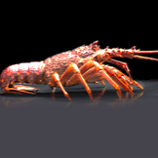
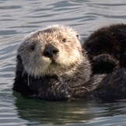
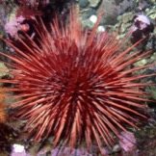
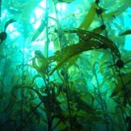
the abundance of some species can influence the abundance of others
n₁
n₂
n₃
Notes:
COntrollabilitys premise arises from the fact that some species can infliece ohert

Slide 27
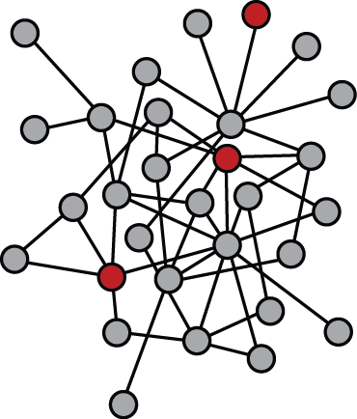
a species’ control capacity indicates how important the species is for determining the state of a community
Notes:
First there is a minimunm number of species that need to be controlled.
Second, there are often many control configurations. Using the minomim
There are many ways to control a complex network.

Slide 28
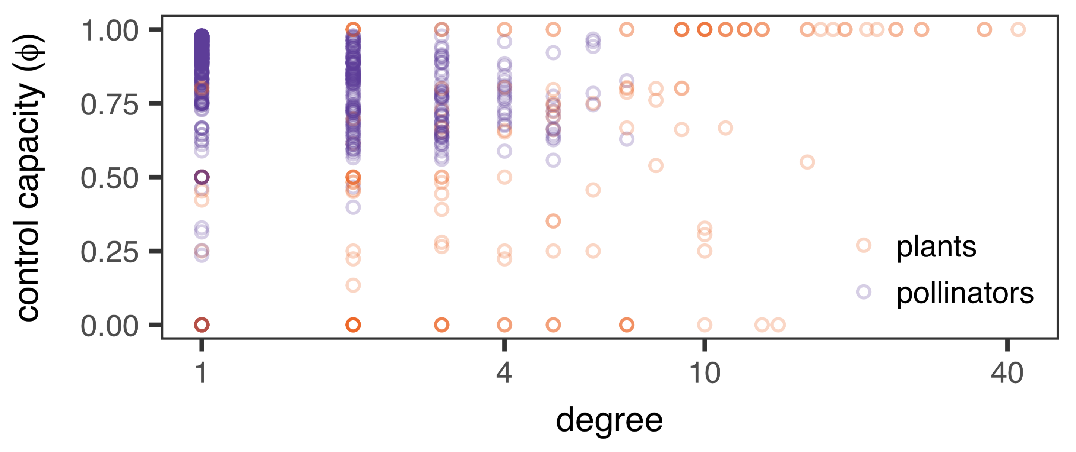
there is not a direct relationship between number of partners and control capacity

Slide 29
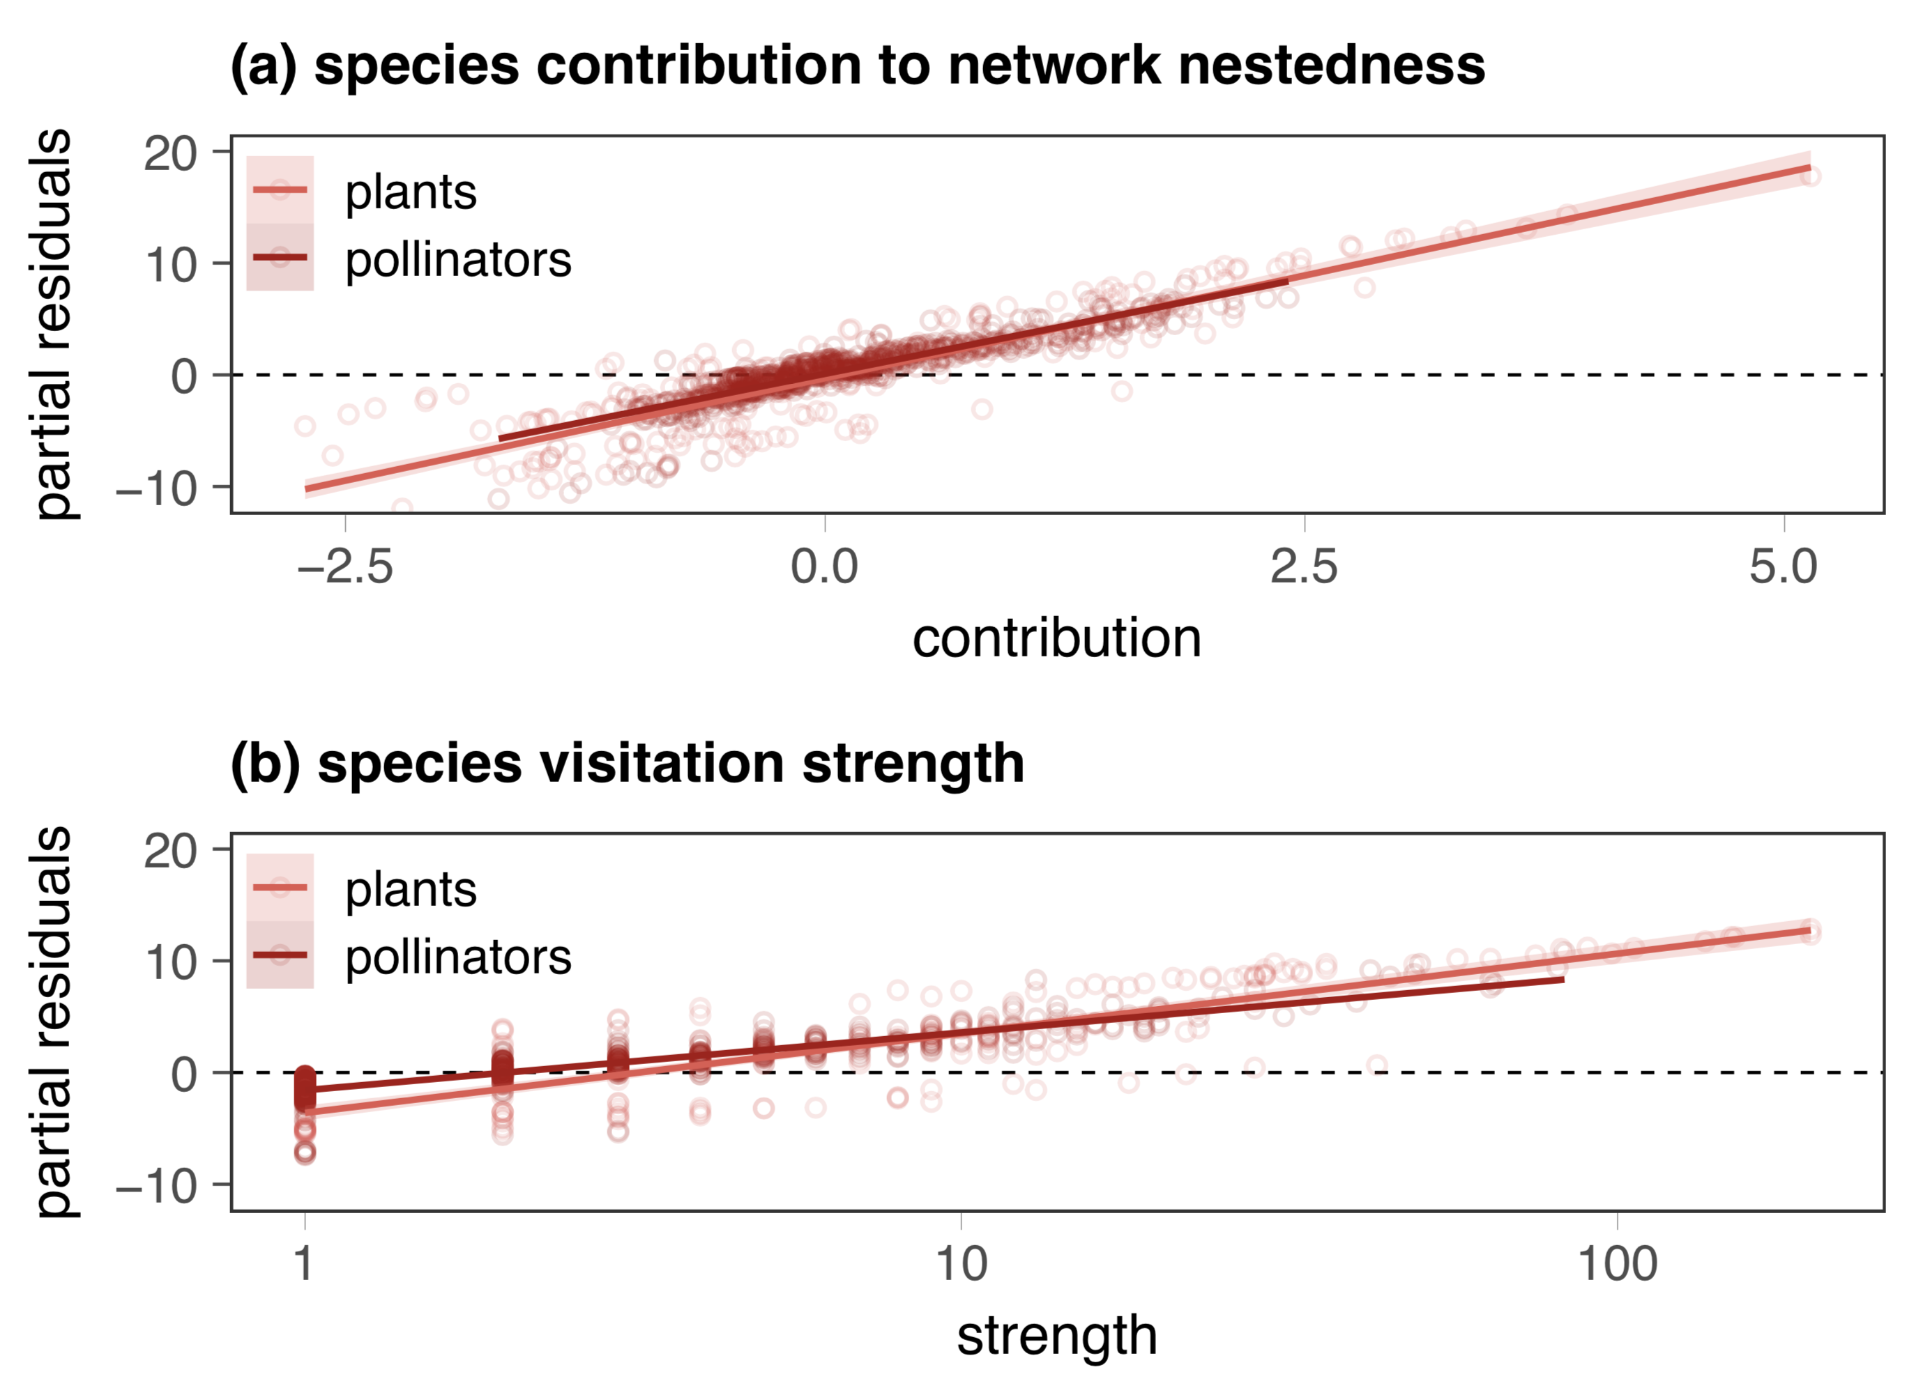
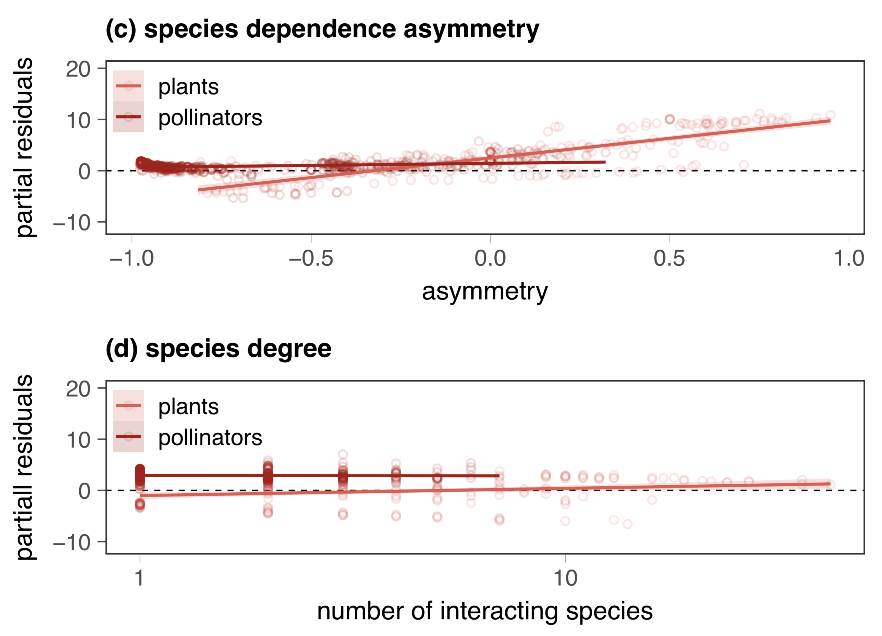
number of partners is a poor predictor when other information is available

Slide 30
TAKE HOME MESSAGES

Slide 31
GENERALISATION IS RELATIVE – COMMUNITY IS KEY

Slide 32
GENERALISATION IS RELATIVE – COMMUNITY IS KEY
HAVING LOTS OF PARTNERS HAS TRADE-OFFS

Slide 33
GENERALISATION IS RELATIVE – COMMUNITY IS KEY
HAVING LOTS OF PARTNERS HAS TRADE-OFFS
GENERALISTS ARE KEY, BUT SOME SPECIALISTS TOO

Slide 34
UPDATES

Slide 35
CHAPTER 1
two drafts from the version submitted
changes focus on introduction and discussion
Notes:
This would be the 10th paper published after I started my PhD at UC

Slide 36
PUBLISHED
JD DiBattista, P Saenz-Agudelo, MJ Piatek, EF Cagua, BW Bowen, JH Choat, LA Rocha, MR Gaither, JPA Hobbs, TH Sinclair-Taylor, JH McIlwain, MA Priest, CD Braun, NE Hussey, ST Kessel, ML Berumen (2019) Population genomic response to geographic gradients by widespread and endemic fishes of the Arabian Peninsula. Ecology and Evolution. 10, 4314-4330
Notes:
This would be the 10th paper published after I started my PhD at UC

Slide 37
PUBLISHED
JD DiBattista, P Saenz-Agudelo, MJ Piatek, EF Cagua, BW Bowen, JH Choat, LA Rocha, MR Gaither, JPA Hobbs, TH Sinclair-Taylor, JH McIlwain, MA Priest, CD Braun, NE Hussey, ST Kessel, ML Berumen (2019) Population genomic response to geographic gradients by widespread and endemic fishes of the Arabian Peninsula. Ecology and Evolution. 10, 4314-4330
EF Cagua, KL Wootton, DB Stouffer (2019) Keystoneness, centrality, and the structural controllability of ecological networks. Journal of Ecology. 107, 1779-1790
EF Cagua, JEM Cochran, CA Rohner, CEM Prebble, TH Sinclair-Taylor, SJ Pierce, ML Berumen (2015) Acoustic telemetry reveals cryptic residency of whale sharks. Biology Letters. 1, 4:20150092
LIE Couturier, P Newman, FRA Jainie, MB Bennett, WN Venables, EF Cagua, KA Townsend, SJ Weeks, AJ Richardson (2018) Variation in occupancy and habitat use of Mobula alfredi at a major aggregation site. Marine Ecology Progress Series. 599, 125-142
JEM Cochran, CD Braun, EF Cagua, MF Campbell Jr., RS Hardenstine, A Kattan, MA Priest, TH Sinclair-Taylor, GB Skomal, S Sultan, L Sun, SR Thorrold, ML Berumen (2019) Multi-method assessment of whale shark residency, distribution, and dispersal behavior at an aggregation site in the Red Sea. Plos One. 14, e0222285
M Hutchinson, EF Cagua, DB Stouffer (2017) Cophylogenetic signal is detectable in pollination interactions across ecological scales. Ecology. 98, 10:2640-2652
J López-Angarita, A Tilley, JM Díaz, JP Hawkins, EF Cagua, CM Roberts (2018) Winners and losers in area-based management of a small scale fishery in the Colombian Pacific. Frontiers in Marine Science. 5, 23
AR Cirtwill, GV Dalla Riva, MP Gaiarsa, MD Bimler, EF Cagua, C Coux, DM Dehling (2018) A review of species role concepts in food webs. Food Webs. 19, 2352-2496
M Hutchinson, EF Cagua, JA Balbuena, DB Stouffer, T Poisot (2017) paco: implementing procrustean approach to cophylogeny in R. Methods in Ecology and Evolution. 8, 8:932-940
CA Rohner, AJ Armstrong, SJ Pierce, CEM Prebble, EF Cagua, JEM Cochran, ML Berumen, AJ Richardson (2015) Whale sharks target dense prey patches of sergestid shrimp off Tanzania. Journal of Plankton Research. 37, 2:352-362
Notes:
This would be the 10th paper published after I started my PhD at UC

Slide 38
PUBLISHED
JD DiBattista, P Saenz-Agudelo, MJ Piatek, EF Cagua, BW Bowen, JH Choat, LA Rocha, MR Gaither, JPA Hobbs, TH Sinclair-Taylor, JH McIlwain, MA Priest, CD Braun, NE Hussey, ST Kessel, ML Berumen (2019) Population genomic response to geographic gradients by widespread and endemic fishes of the Arabian Peninsula. Ecology and Evolution. 10, 4314-4330
IN PRESS
CA Rohner, JEM Cochran, EF Cagua, CEM Prebble, SK Venables, ML Berumen, BL Kuguru, J Rubens, JM Brunnschweiler, SJ Pierce (2020) No place like home? High residency and predictable seasonal movement of whale sharks off Tanzania. Frontiers in Marine Science
Notes:
This would be the 10th paper published after I started my PhD at UC

Slide 39
PUBLISHED
JD DiBattista, P Saenz-Agudelo, MJ Piatek, EF Cagua, BW Bowen, JH Choat, LA Rocha, MR Gaither, JPA Hobbs, TH Sinclair-Taylor, JH McIlwain, MA Priest, CD Braun, NE Hussey, ST Kessel, ML Berumen (2019) Population genomic response to geographic gradients by widespread and endemic fishes of the Arabian Peninsula. Ecology and Evolution. 10, 4314-4330
IN PRESS
CA Rohner, JEM Cochran, EF Cagua, CEM Prebble, SK Venables, ML Berumen, BL Kuguru, J Rubens, JM Brunnschweiler, SJ Pierce (2020) No place like home? High residency and predictable seasonal movement of whale sharks off Tanzania. Frontiers in Marine Science
UNDER REVIEW
EF Cagua, HJ Marrero, JM Tylianakis, DB Stouffer. The trade-offs of sharing pollinators: pollination service is determined by the community context
AJ Burt, EF Cagua, C Sanchez, J van de Crommenacker, N Shah, N Bunbury. Combining monitoring data from multiple sites to assess population status and trends of white-tailed tropicbirds (Phaethon lepturus)
JC Appoo, EF Cagua, J van de Crommenacker, AJ Burt, P Pisorius, F Taylor, H Richards, P Haupt, N Doak, F Fleischer-Dogley, N Bunbury. Population dynamics of the coconut crab (Birgus latro), on Aldabra Atoll, Seychelles
Notes:
This would be the 10th paper published after I started my PhD at UC

Slide 40
MANY THANKS!
Chris & Nacho for reviewing the thesis
Ian for facilitating this
Daniel & Jason for reading what feels like hundreds of drafts

